Slide 1

Go, change the world
RV College of
Engineering
Rapid Miner Tool

Slide 2
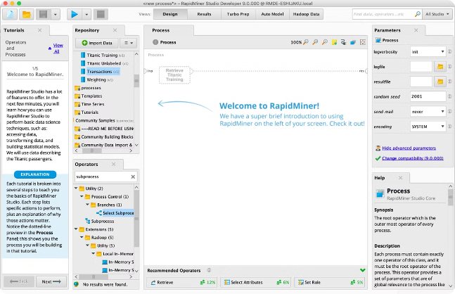
Introduction to Rapid Miner Tool
Rapid Miner is a robust and user-friendly data science platform utilized for machine learning and predictive analysis. With its intuitive interface and wide array of tools, it empowers users to easily build AI and machine learning models without extensive coding knowledge.

Slide 3
Introduction to Rapid Miner Tool
RapidMiner is a comprehensive data science platform that provides an integrated environment for data science, machine learning, and artificial intelligence
It’s a powerful tool that simplifies the entire data analytics process, allowing you to import, preprocess, and analyze data without the need for complex coding

Slide 4
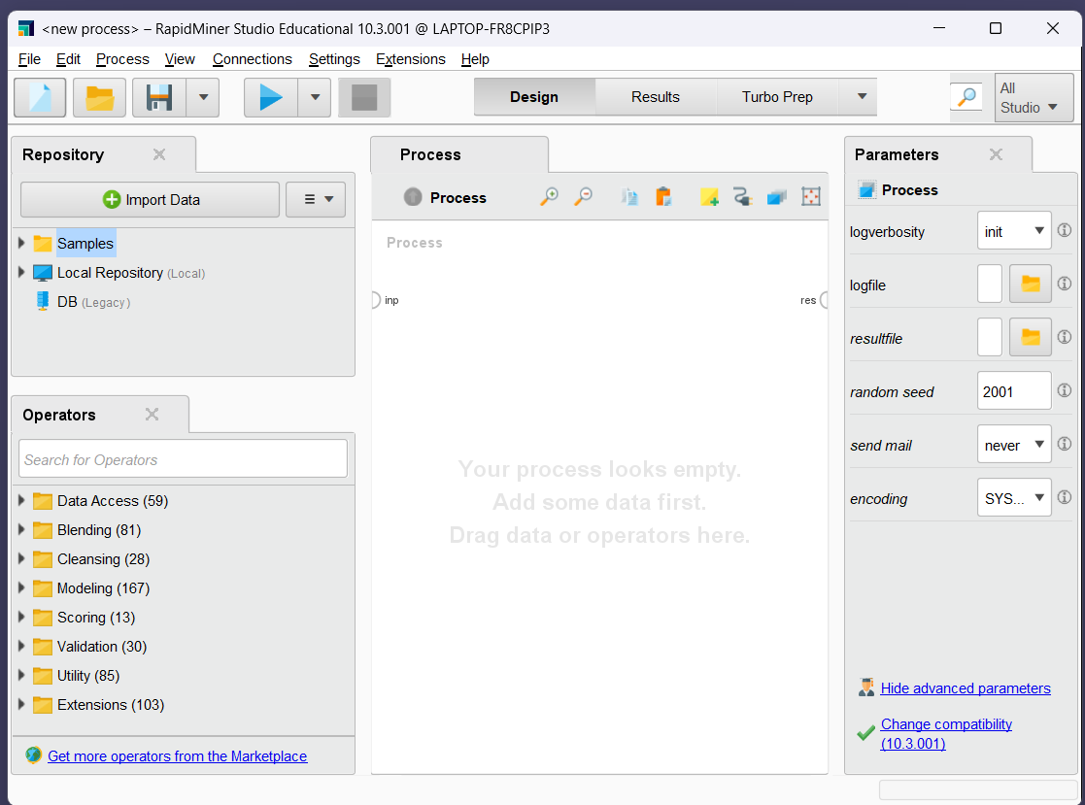
Repository
Parameters
Data and Storage
Settings to control the behaviour of an operator
Operators
Building Blocks (functions) to create Processes.
There are over 1500 operators
Process

Slide 5

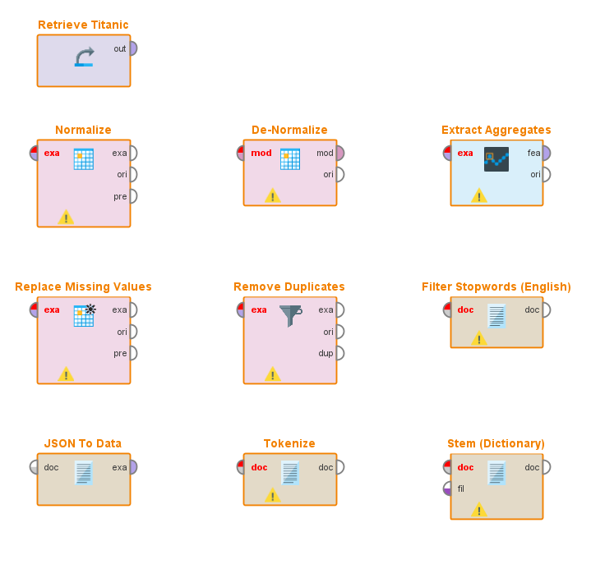
Data Preprocessing in Rapid Miner
Data Collection: Acquiring & importing data from various sources.
Data Cleaning: Handling missing values, duplicates, outliers.
Data Transformation: Normalizing, De-normalizing, and feature engineering.

Slide 6
Key Features of Rapid Miner
Powerful Data Preparation
Advanced Modeling Capabilities
Rapid Miner offers robust tools for data cleaning, transformation, and integration.
It provides a wide range of machine learning and predictive modeling algorithms.
Scalability and Performance
Integrated Data Science Workflows
Rapid Miner is designed to handle large-scale data and ensure high performance.
Streamlined workflows for end-to-end data science processes and collaboration.

Slide 7
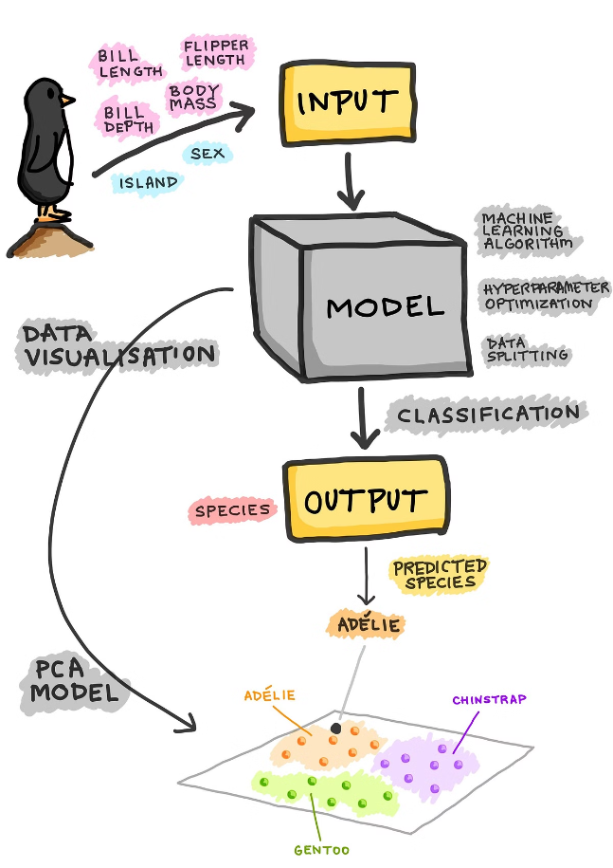
Building Machine Learning Models in RapidMiner
When building machine learning models in RapidMiner, we start by choosing the data. We import the dataset to REPOSITORY
We can apply data preprocessing to clean the data
Then, choose appropriate algorithms from the OPERATORS and optimize their parameters to achieve accurate models
Run the model and we can evaluate the statistics and analyze the results in various forms

Slide 8
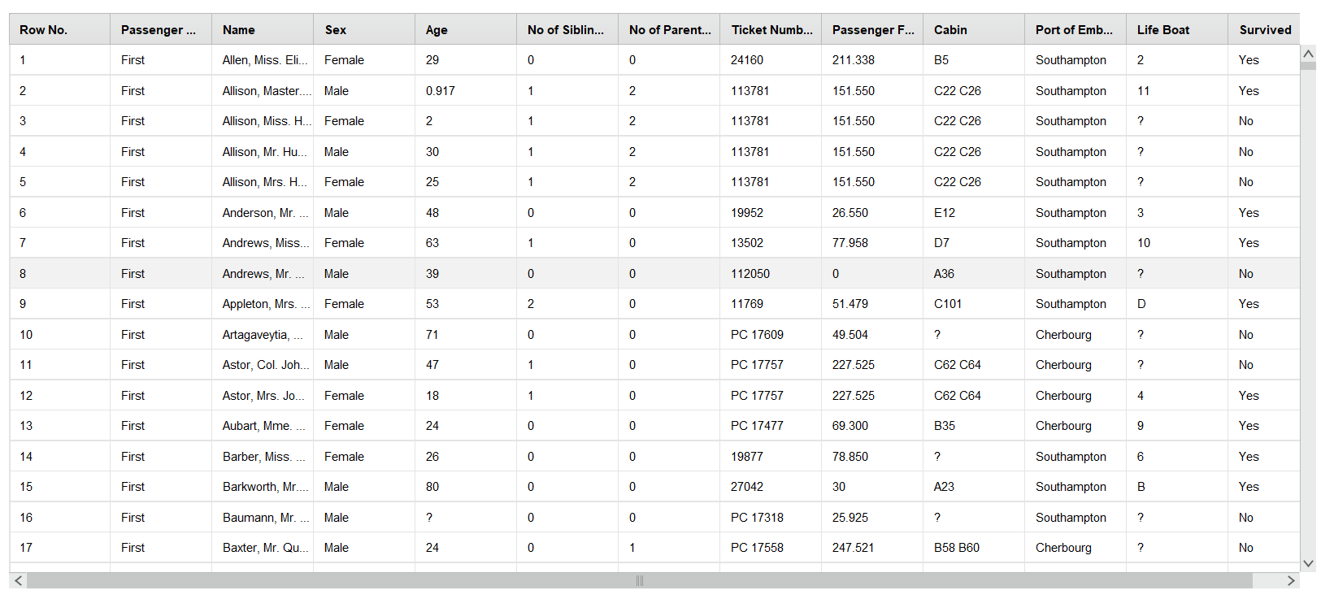
Project: Titanic Survivors Analysis
Dataset

Slide 9
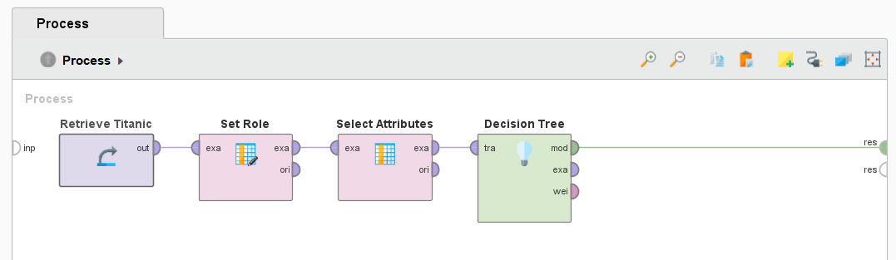
MODEL Configuration
SET ROLE: Attribute = Survived, Target = Label
ATTRUBUTES: Passenger Fare, Gender, Family, Age
ALGORITHM: Decision Tree

Slide 10
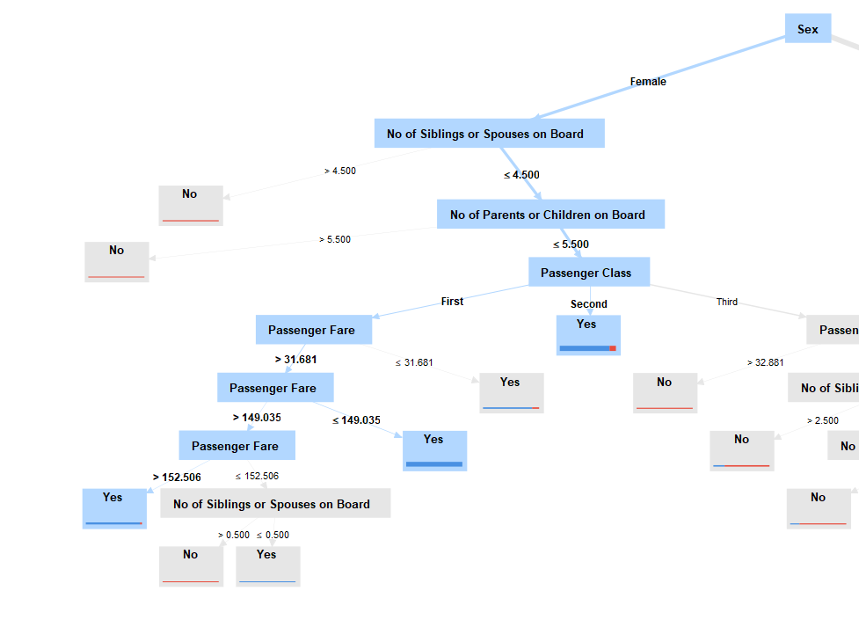
RESULTS
Passengers in the First Class who paid over $152.506 for the Ticket has SURVIVED
Female Passengers in the Second Class who had their parents on board has Survived
We can observe the correlation of Survival chances with the Passenger Fare, Class, Gender and Family background of the Passengers

Slide 11
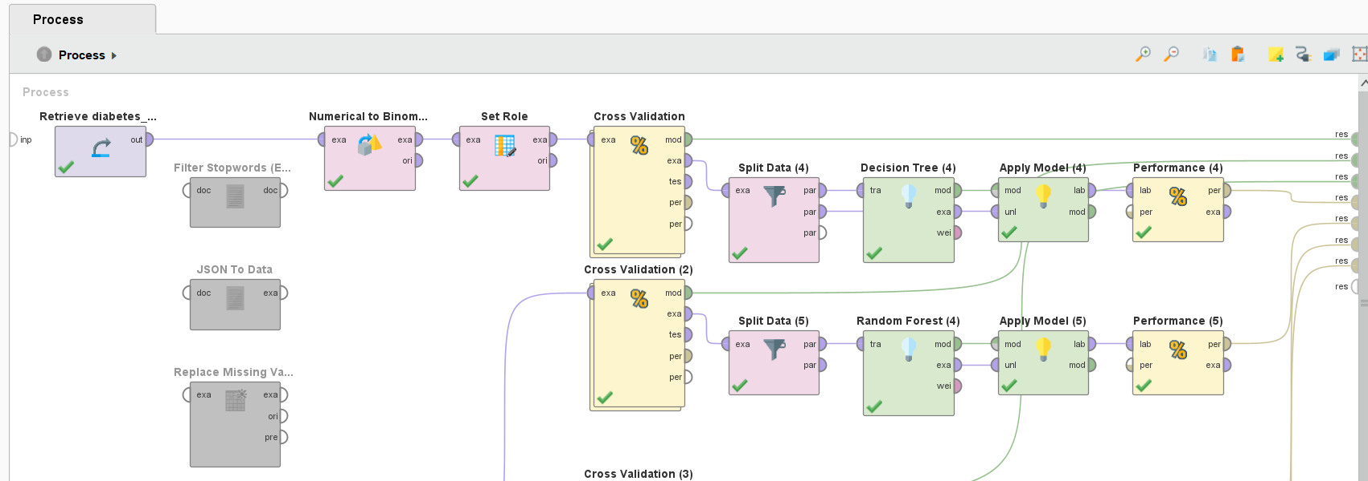
PROJECT: Diabetes Classification
Process Flow
Models Used:
Decision Tree
Random Forest

Slide 12
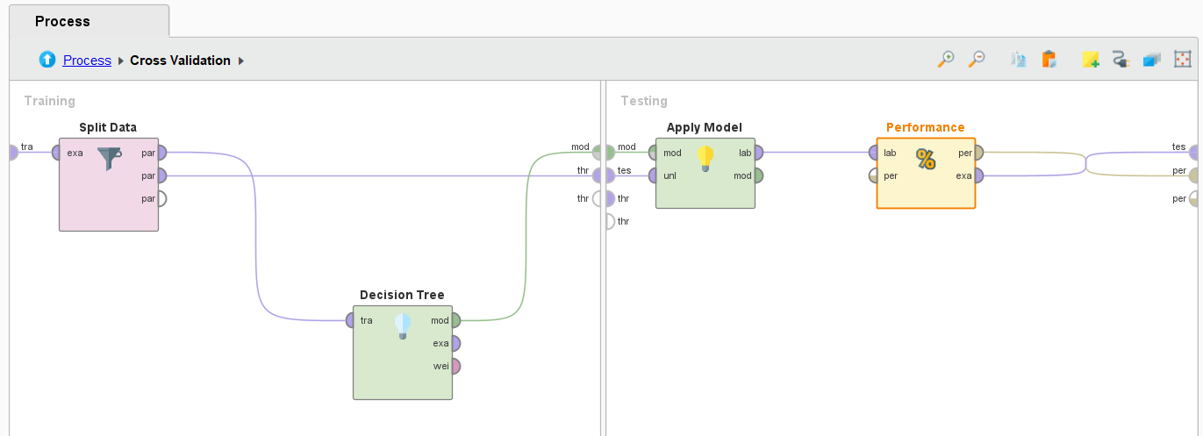
Data Validation
Test – Train split to cross validate the dataset

Slide 13
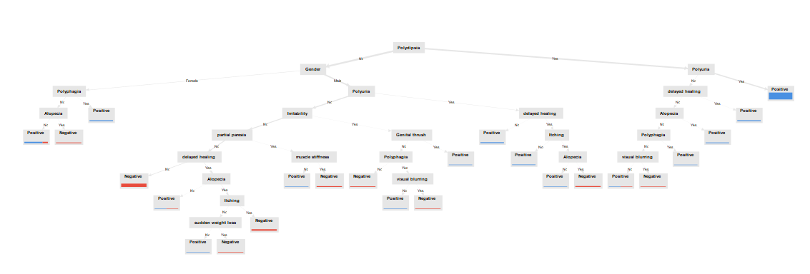
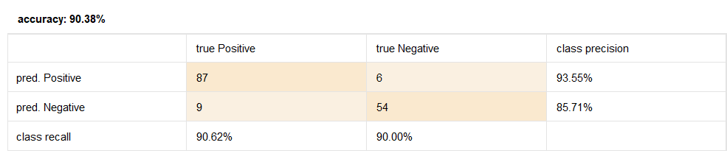
Decision Tree
Result: 90.38%
Examining true positives, true negatives, false positives,
and false negatives for classification models.

Slide 14
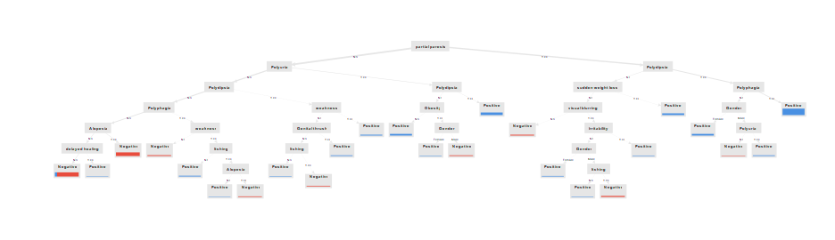
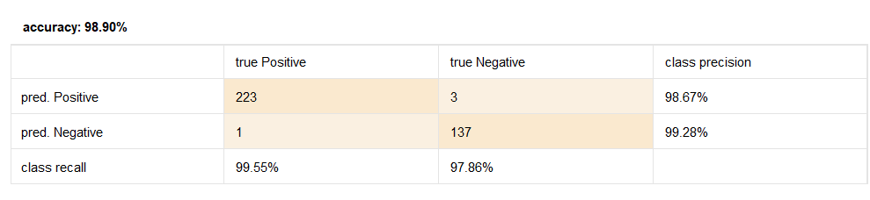
Random Forest
Result: 98.90%
Examining true positives, true negatives, false positives,
and false negatives for classification models.

Slide 15
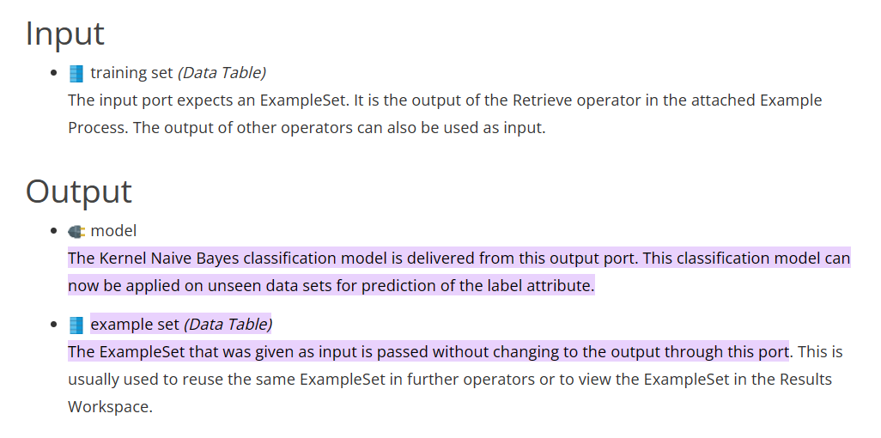
Naïve Bayes Classifier
A Naive Bayes classifier is a simple probabilistic classifier based on applying Bayes' theorem (from Bayesian statistics) with strong (naive) independence assumptions.

Slide 16
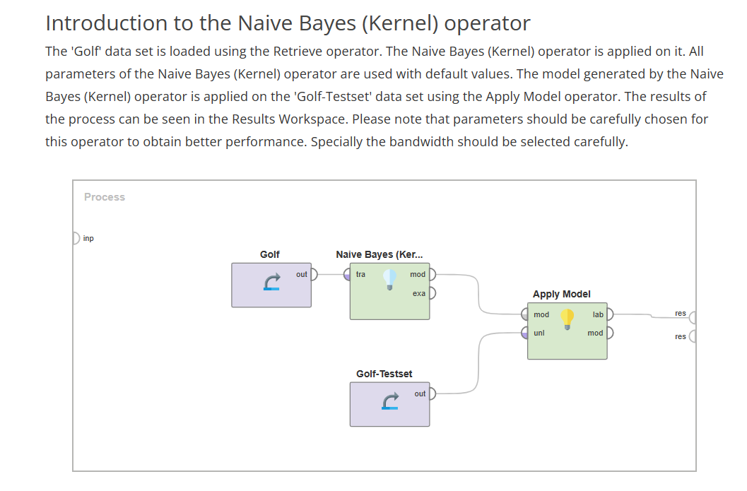

Slide 17
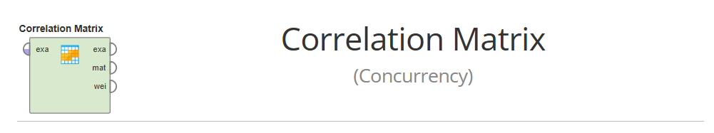
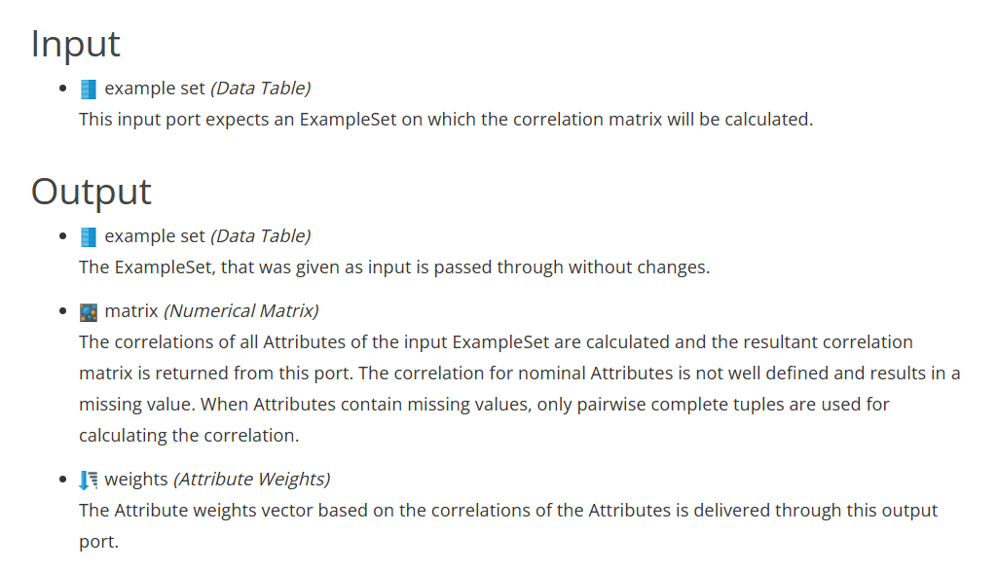
A correlation is a number between -1 and +1 that measures the degree of association between two Attributes (call them X and Y).

Slide 18
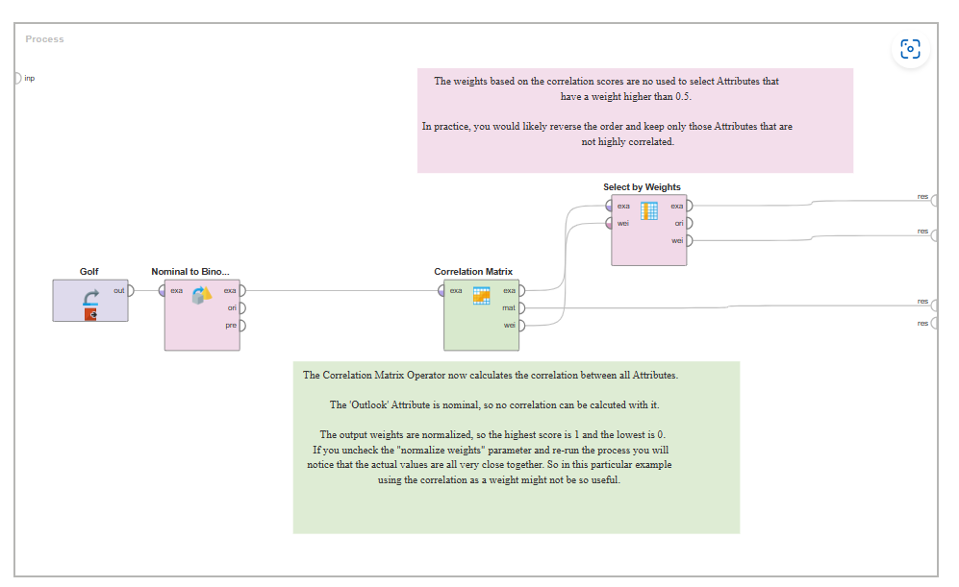
Correlation matrix of the Golf data set

Slide 19




Use Cases of Rapid Miner in AI and ML
Predictive Analytics
Data Classification
Data Visualization
Process Automation
Rapid Miner provides tools for creating visual representations of data for easy interpretation.
Rapid Miner is used to forecast future outcomes based on historical data and trends.
It helps in categorizing data into different classes or groups based on various attributes.
Automating repetitive tasks in data preparation, model building, and evaluation.

Slide 20

Conclusion and Next Steps
After learning about the key features, data preprocessing, model building, and evaluation in Rapid Miner, it's time to explore practical application and integration. The next steps involve hands-on practice, experimenting with different datasets, and incorporating the models into real-world scenarios. The journey continues with practical use cases and demonstration of a simple application project.
Exploring real-world applications and enhancing expertise in AI and ML will be the focus of the upcoming phase. The journey doesn't end here; it evolves and expands with the application of Rapid Miner in diverse domains and problem-solving scenarios.

Slide 21
Applications in Real World
Healthcare
Retail
RapidMiner is used to analyze patient data for personalized treatment plans.
It helps in customer segmentation and demand forecasting for inventory management.
Finance
Manufacturing
Utilized for fraud detection and risk assessment in banking and insurance.
Optimizes production processes and predictive maintenance for machinery.

Slide 22


